Slide 1
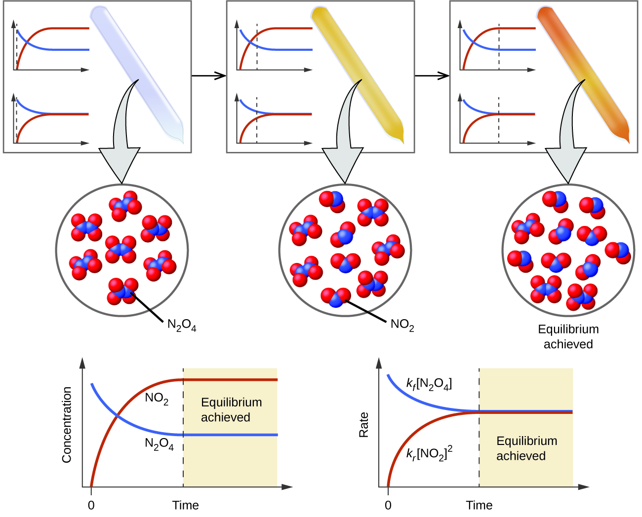
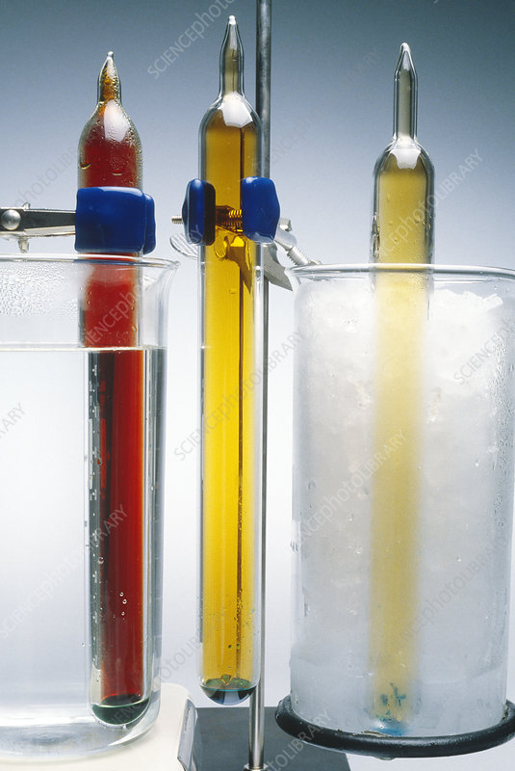
Equilibrium
Equilibrium law and shifts in equilibria
ATAR Chemistry Unit 3 2021

Slide 2

Outline
Equilibrium law (Equilibrium constant expressions)
Effect of shifting the equilibrium
Resources
Essential chemistry ch 2.4 – 2.5, Set 2 Q 7-8
Worksheets on shifting equilibria
STAWA Set 5: Equilibrium constant expressions

Slide 3
Equilibrium law
Recall
The system must be closed, meaning no substances can enter or leave the system.
Equilibrium is a dynamic process. Even though we do not observe any changes, both the forward and reverse reaction are still taking place.
The rates of the forward and reverse reactions must be equal at equilibrium.
The concentrations of the reactants and products may not be equal at the start of the reaction, and they may not be equal after equilibrium is established. However, after equilibrium is attained, the concentrations of reactants and products will remain constant.
Ref: Gary Turner Science

Slide 4

Equilibrium law
Consider the hypothetical reversible reaction below.
aA + bB ⇌ cC + dD
the rates of the forward and reverse reactions are the same at equilibrium, and so the concentrations of all of the substances are constant
The equilibrium constant (Kc) is the mathematical product of the concentrations of the products to the mathematical product of the concentrations of the reactants for a reaction at equilibrium
Each concentration is raised to the power of its coefficient in the balanced chemical equation
$K_{c}= \frac{{[C]}^{c} {[D]}^{d}}{{[A]}^{a}[{B]}^{b}}$

Slide 5
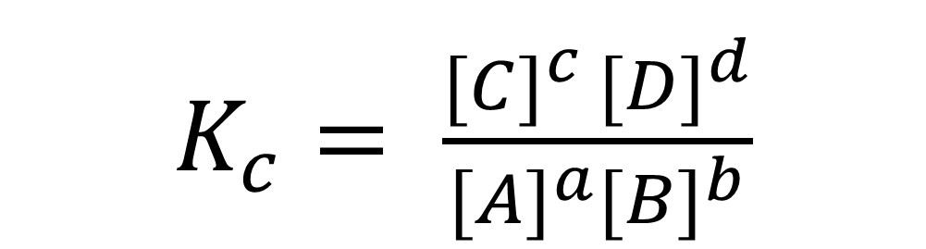
Equilibrium law
Consider the hypothetical reversible reaction below.
aA + bB ⇌ cC + dD
coefficients
Square bracket = concentration in mol L⁻¹
$K_{c}= \frac{{[C]}^{c} {[D]}^{d}}{{[A]}^{a}[{B]}^{b}}$
}
Products (right side)
}
Reactants (left side)
Equilibrium constant
In terms of concentration
coefficients

Slide 6
Equilibrium law
When writing these equilibrium law expressions:
The concentrations of the products are written on the top line of the reaction, and the concentrations of the reactants are written on the bottom line
If there are two or more reactants or products, their concentrations are multiplied together
The power to which the concentration of a particular substance is raised is the coefficient in the equation

Slide 7
Equilibrium law
Only gases and aqueous species appear in equilibrium expression. Solids and liquids have a fixed concentration and so they are not included in the expression
While K has a constant value for all conditions of concentration and pressure its value does change if the temperature changes.
Concentrations are in mol L⁻¹, but Equilibrium constant, Kc, has no units

Slide 8
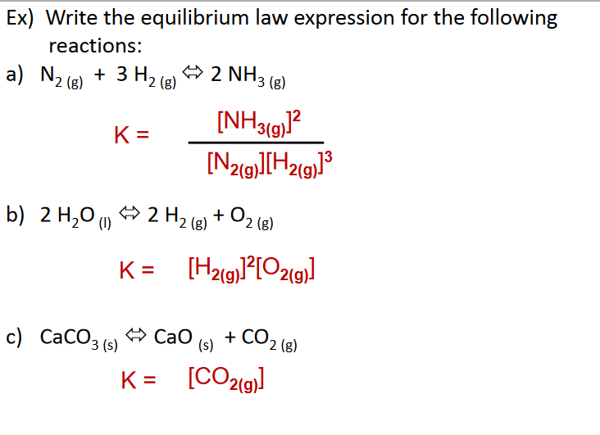

Equilibrium law
Check understanding

Slide 9
Equilibrium law
The magnitude of Kc gives us information about the relative position of the equilibrium
Large values of K imply the equilibrium favours the forward reaction (the products)
Small values of K imply the equilibrium favours the reactants
Value of K close to 1 imply significant concentrations of both reactants and products are present at equilibrium

Slide 10
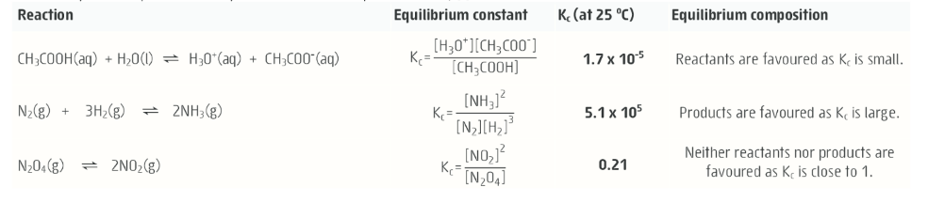
Equilibrium law
Example from Essential Chem:

Slide 11
Equilibrium law
It is a constant value for a particular equation representing a reaction at a given temperature
If the temperature is changed, then the value of the equilibrium constant also changes
It provides no indication of the rate of reaction

Slide 12

Equilibrium law
The reaction quotient Qc is not constant
It depends on the concentration of reagents currently present in the system regardless of whether the system is at equilibrium
You calculate Qc in the same way you do Kc
If Qc = Kc then the system is at equilibrium, if they are not equal then the system has not reached equilibrium
$Q_{c}= \frac{{[C]}^{c} {[D]}^{d}}{{[A]}^{a}[{B]}^{b}}$

Slide 13
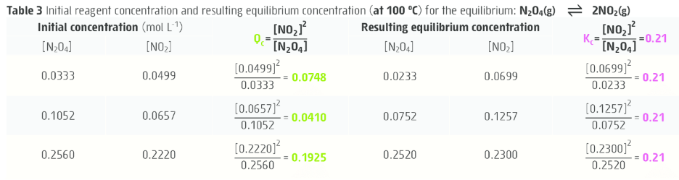
Equilibrium law
Example from Essential Chem:

Slide 14
Le Chatelier’s principle
Chemical equilibrium have an ability to return to a state of equilibrium after alterations, called imposed changes.
The following imposed changes will affect an equilibrium system:
Changing concentration of any one species (ie selectively adding or removing one species from the system)
Changing the total pressure in gaseous systems (ie raising or lowering the volume)
Changing the temperature (ie adding or removing heat from the system)

Slide 15
Le Chatelier’s principle
We can make predictions about the affect an imposed change will have using Le Chatelier’s principle
“If a system at equilibrium is subjected to a change in conditions, the system will adjust to re-establish equilibrium in such a way as to partially counteract (oppose) the imposed changes”

Slide 16
Le Chatelier’s principle
Le Chatelier’s principle is a prediction tool, it is NOT an explanation.
To explain the affect an imposed change has on an equilibrium system we use collision theory.
Over the next few lessons we will look at each type of imposed changed and how to explain the affect in terms of collision theory and using graphical representations

Slide 17
Le Chatelier’s principle
Le Chatelier’s principle – note we use specific language when discussing changes in equilibrium. Equilibrium are said to “shift”, “lie” or “favour”
Predictions concentration summary:
Imposed change | Response
addition of reactant | forward reaction favoured
addition of product | reverse reaction favoured
removal of reactant | reverse reaction favoured
removal of product | forward reaction favoured

Slide 18
Le Chatelier’s principle
Predictions pressure summary:
Imposed change | Response
pressure increase | reaction produces fewer gas molecules
pressure decrease | reaction produces more gas molecules
Predictions temperature summary: Note – both forward and reverse reaction increase initially, then a new equilibrium with a new Kc value is established
Imposed change | Response
Increase in temperature | Endothermic reaction favoured
Decrease in temperature | Exothermic reaction favoured

Slide 19
Le Chatelier’s principle
Catalyst use on Equilibrium
Since a catalyst speeds up the rate of a reaction, you might think that it would have an effect on the equilibrium position. However, catalysts have equal effects on the forward and reverse rates, so for a system at equilibrium, these two rates remain equal.
A system will reach equilibrium more quickly in the presence of a catalyst, but the equilibrium position itself is unaffected.

